Slide 1

Department of Computer Science and Engineering
Course Code: CSE207
Course Title: Data Structure
Section: 07
Group No: 05
Presentation Topic: Rat In a Maze
Submitted By:
Prottoy Debnath (2020-3-60-080)
Sheikh Sarafat Hossain (2022-3-60-109)
Rijia Parveen Raya (2022-3-60-192)
Sayma Sultana (2021-3-60-105)
Submitted To:
Dr. Md. Manowarul Islam
Associate Professor, Department of CSE

Slide 2
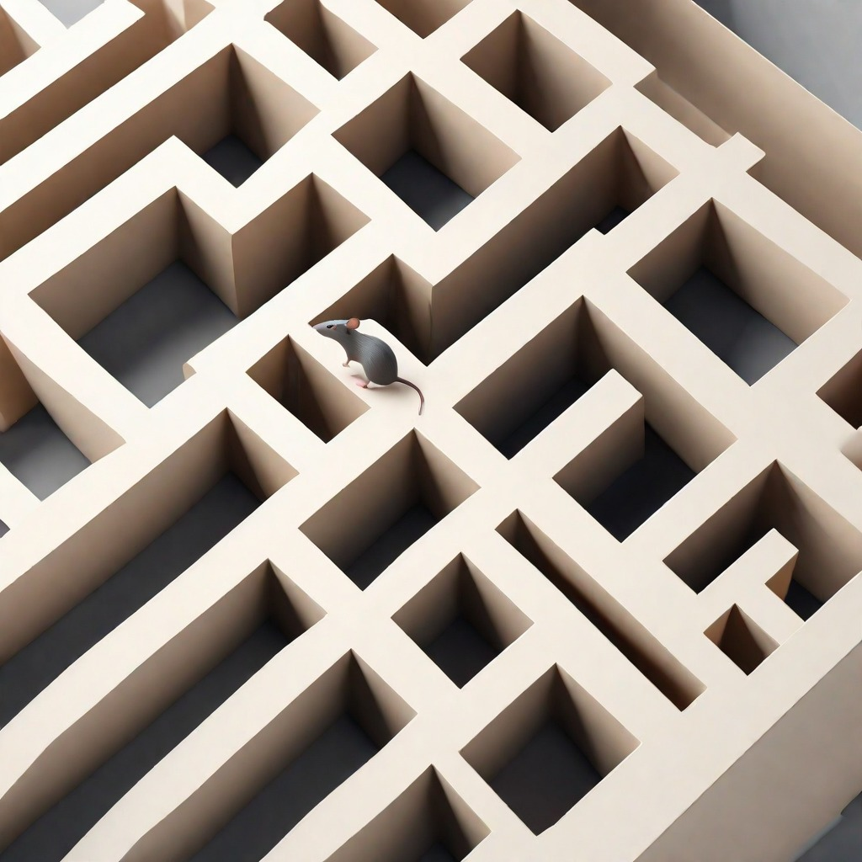
Introduction
The Rat in a Maze problem is a classic problem in computer science and is often used to illustrate the significance of data structures.

Slide 3
Problem Statement
The Rat in a Maze problem is a classic computer science problem that involves finding a path in a maze from the starting point to the destination point. The maze is represented as a grid, where each cell can be either empty or blocked. The problem can be solved using various algorithms and data structures, such as backtracking and depth-first search. The algorithm explores all possible paths in the maze until it finds a valid path to the destination.

Slide 4
General Strategy
To solve the Rat in a Maze problem, we can use a backtracking approach. The general strategy is as follows:
Start from the initial position of the rat. Move the rat in all possible directions (up, down, left, right) and check if it is a valid move.
If the move is valid, mark the current cell as part of the solution path and recursively repeat steps 2 and 3 for the next cell.
If none of the moves from the current cell are valid, backtrack to the previous cell and try a different direction.
Repeat steps 2 to 4 until the rat reaches the destination cell or all possible paths have been explored.

Slide 5

Algorithm
Step-by-Step Algorithm
Start at the entrance of the maze.
Check if the current position is the exit of the maze. If yes, the algorithm terminates.
If the current position is not the exit, check if it is a valid move; If the move is valid, mark the current position as visited and move to the next position.
If the move is not valid, backtrack to the previous position and try a different direction.

Slide 6
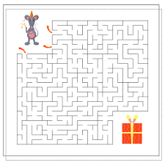
Implementation
The Rat in a Maze problem can be solved using a backtracking algorithm. The algorithm explores all possible paths in the maze to find a valid path from the starting position to the destination.

Slide 7
Complexity Analysis
Time Complexity
The time complexity of the Rat in a Maze algorithm is O(2^n), where n is the size of the maze.
Space Complexity
The space complexity of the Rat in a Maze algorithm is O(n^2), where n is the size of the maze.

Slide 8
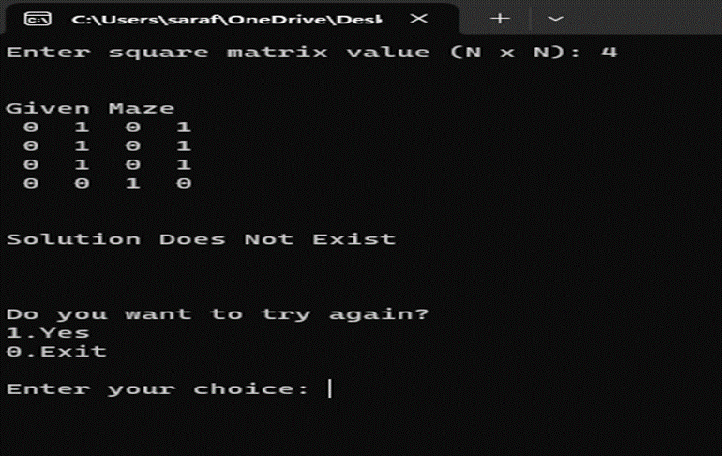
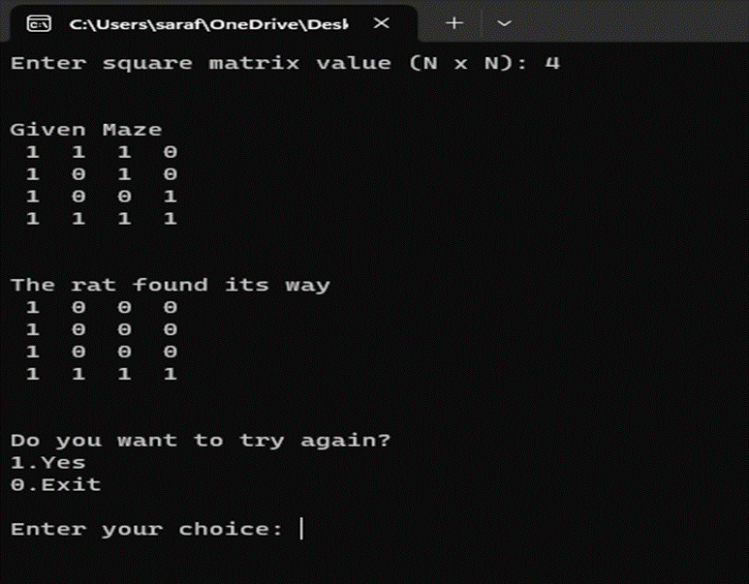
Output
No solution
With solution

Slide 9
Result and conclusion
Project Outcomes The Rat in a Maze project aimed to solve the classic problem of finding a path for a rat to reach the destination in a maze. Through extensive research and implementation, we achieved the following outcomes :
1.Successfully developed an algorithm to solve the Rat in a Maze problem.
2. Implemented the algorithm in a way that efficiently finds the shortest path from the starting point to the destination.
3. Verified the correctness and effectiveness of the algorithm through extensive testing and analysis.

Slide 10
Thank You

